Slide 1



K-Paths: Reasoning over Graph Paths for Drug Repurposing
& Drug Interaction Prediction
Abdullahi, T., Gemou, I., Nayak, N. V., Murtaza, G., Bach, S. H., Eickhoff, C., & Singh, R.
Presented by: Tassallah Amina Abdullahi

Slide 2
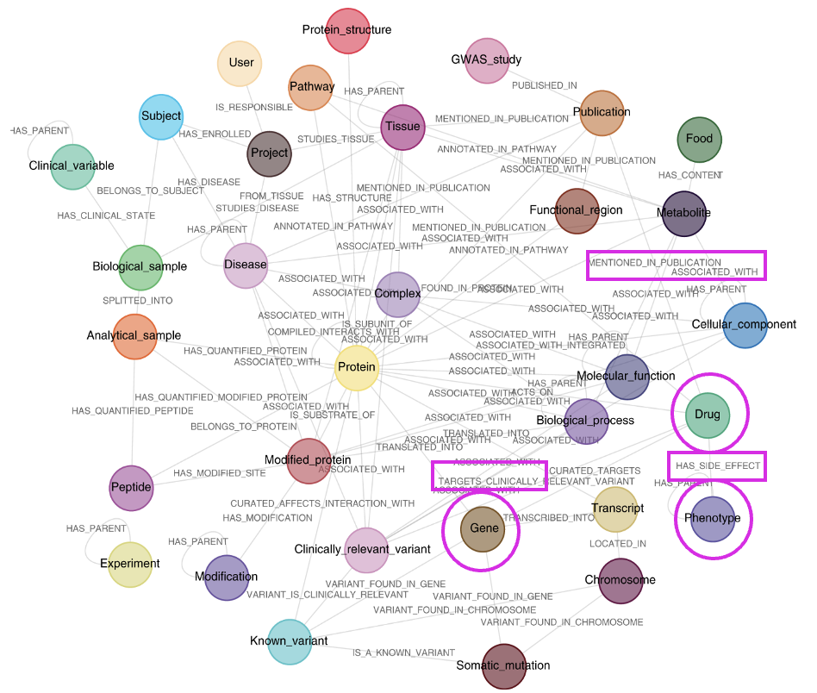
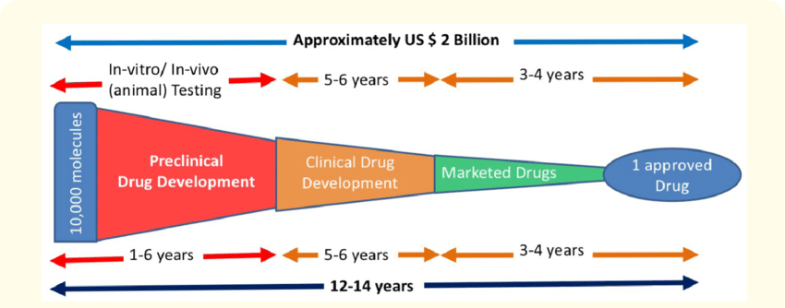
Uncovering New Drug Uses or Risks is like Finding Needles in a Haystack
Drug development is time-intensive and costly
Knowledge graphs (KGs) are valuable for drug discovery tasks,
but they are large and expensive to reason over
Notes:
In drug discovery, finding new uses for existing drugs or predicting harmful interactions is critical —
But because of countless of possibilities, the tasks becomes like finding needles in a haystack.
Biomedical knowledge graphs help in modelling and connecting entities but they’re huge and hard to reason over.

Slide 3
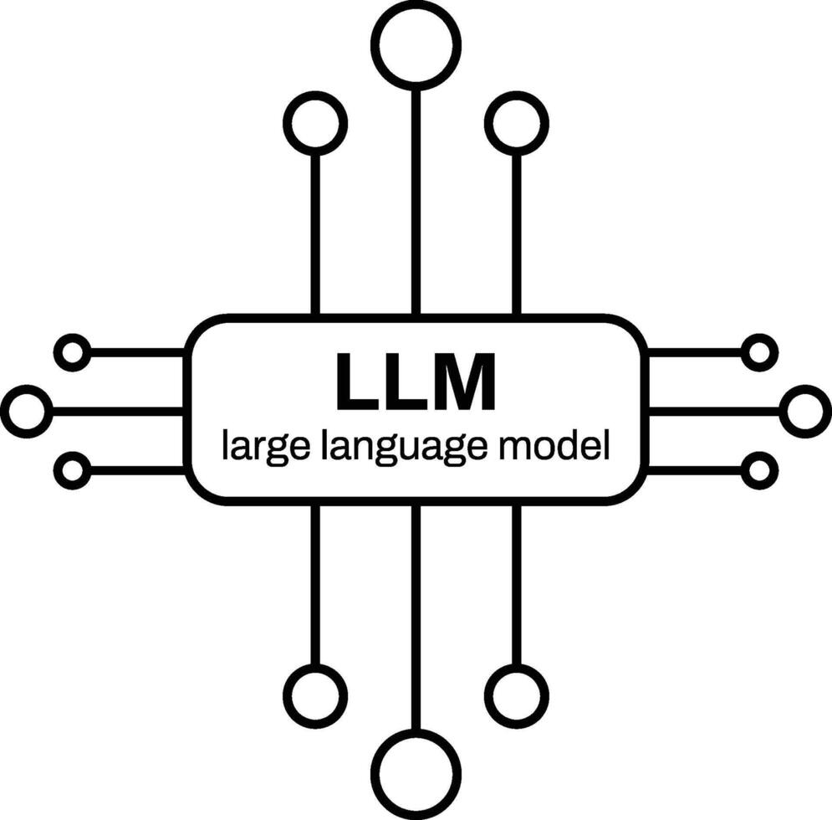
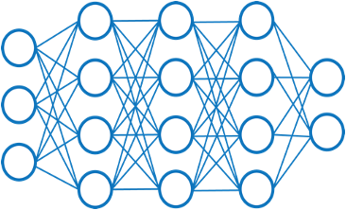

Computational Tools have the Potential to Speed up Drug Discovery Tasks
Graph Neural Networks (GNNs)
Training GNNs on large-scale graphs is computationally expensive.
LLMs can generalize well to new tasks (zero-shot predictions) but drug discovery is domain heavy.
GNNs cannot generalize to tasks they have not seen.
LLMs are not designed to directly utilize graphs.
Goal 1: Can we make reasoning models (LLMs) leverage KG more effectively?
Goal 2: Can we make GNN training more efficient?
Notes:
GNNs can encode graphs but training them is expensive and they do not generalize to unseen tasks.
LLMs can generalize to unseen classes but the drug discovery domain needs to be grounded in evidence.
Hence the need for Knowledge graphs but LLMs can’t encode large KGs directly
That’s where knowledge graphs come in — but LLMs can’t ingest large graphs directly."

Slide 4
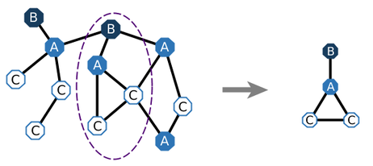
Main Insight: We may not need the Entire KG for Predictions
While typical KGs contain thousands of nodes and millions of edges, only a small subgraph is often relevant for a given task [Yu et al. 2021]
Task Example : Is Drug A related to Drug B ?
Entire KG
Relevant subgraph

Slide 5
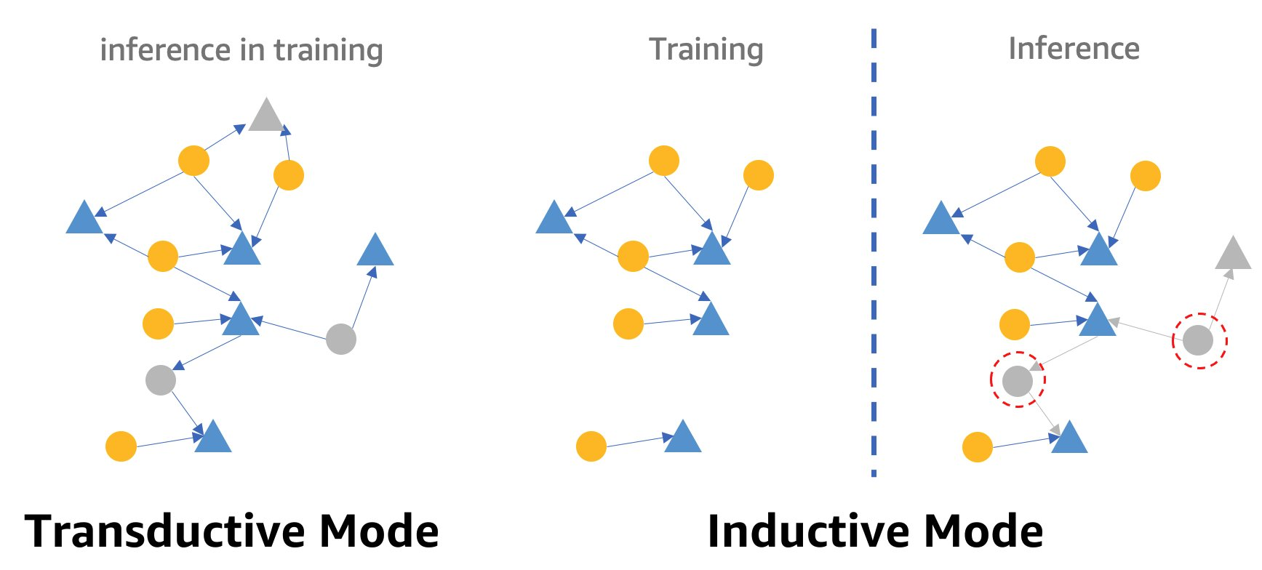
Problem Formulation: Inductive Reasoning
Notes:
Given a network of observed interactions among known entities (drugs or diseases) and a broader biomedical network containing additional relationships between various entities (e.g., drugs, diseases, genes, etc.). The task is to predict unobserved interactions between a known entity and an emerging entity or two emerging entities. (b) Augmented KG: The observed interactions and biomedical network are integrated to create a richer representation for the prediction task.

Slide 6
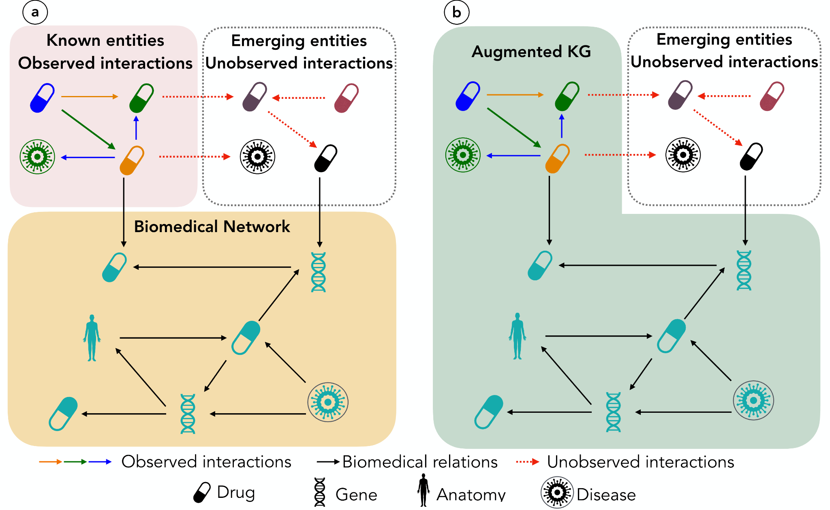
Problem Formulation: Inductive Reasoning
Available data: Given a network of observed interactions among known entities (drugs or diseases)
Ideation : The observed interactions and biomedical network are integrated to create a richer representation for the prediction task.
External Knowledge: a broader biomedical network with additional relationships between various entities (drugs, diseases, genes, etc.).
Task: Reason over the KG to predict unobserved interactions between a known entity and an emerging entity or two emerging entities.
Notes:
Given a network of observed interactions among known entities (drugs or diseases) and a broader biomedical network containing additional relationships between various entities (e.g., drugs, diseases, genes, etc.). The task is to predict unobserved interactions between a known entity and an emerging entity or two emerging entities. (b) Augmented KG: The observed interactions and biomedical network are integrated to create a richer representation for the prediction task.

Slide 7
Previous Studies on KGs & LLMs for Drug Discovery
Inductive reasoning over KGs for drug discovery tasks have predominantly been GNN based
EmerGNN, 2023
CSSE-DDI, 2024
Tasks involving KGs + LLMs have mainly focused on:
Hybrid training of GNN + LLMs (GraphLLM, 2023)
Training a subgraph extraction module (ROG, GNN-RAG ,2024)
Reasoning over Smaller Graphs (KG-LLM, 2024)
Notes:
smaller graphs,
hybrid GNN+LLMs,
training an LLM to l

Slide 8
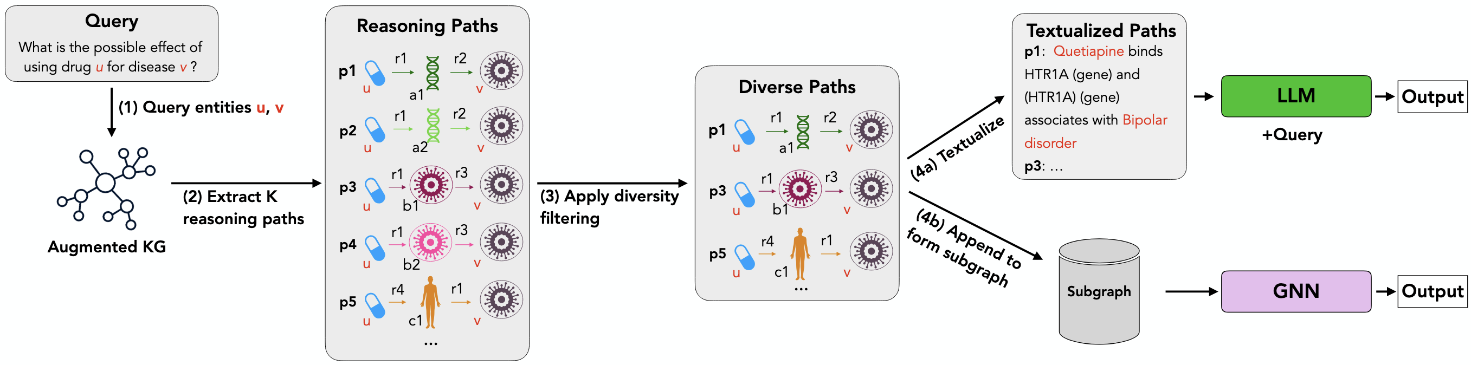
Our Method: K-Paths is Model Agnostic and Works Off the Shelf
Zero-shot Learning
Supervised Learning
K-Paths is a novel path retrieval framework that extracts relevant and diverse reasoning paths from large biomedical knowledge graphs.
Notes:
We introduce K-Paths, a novel framework that extracts relevant and diverse reasoning paths from KGs.
K-Paths is model agnostic which means that, the retrieved paths can be utilized by LLMs for effective zero-shot learning and also utilized by GNNs for efficient supervised learning.

Slide 9






Finding K Shortest Paths with Yen's Algorithm
Building Block: Uses Dijkstra's Algorithm iteratively
r4
r4
r4
r5
r3
r5
r4
r6
r3
r5
r3
r4
r6
r4
r6
r3
r7
r3
r7
r3
u
r7
u
u
r2
r8
r2
r8
r2
r7
r8
r7
r1
r7
r1
r1
r1
r1
r1
v
v
v
K =1: u – r7 – disease –r7 – v
K = 1: u – r7 – disease –r3 –gene-r2- v
Notes:
Finding K Shortest Paths with Yen's Algorithm
Using Dijkstra's Algorithm as a Building Block
Efficient discovery of multiple loopless routes in a graph

Slide 10
Finding K Shortest Paths with Yen's Algorithm
r4
r4
r4
r5
r3
r5
r3
r5
r4
r6
r3
r4
r6
r4
r6
u
r7
r3
u
r7
r3
u
r7
r3
r8
r7
r2
r8
r7
r2
r8
r7
r2
r1
r1
r1
r1
r1
r1
v
v
v
Remove: edge r7
K= 2: u – r1 – anatomy –r1 –v
Remove: edges r7 & r1
K = 3: u – r5 – gene –r4 –disease-r7-v
K =1: u – r7 – disease –r7 –v

Slide 11
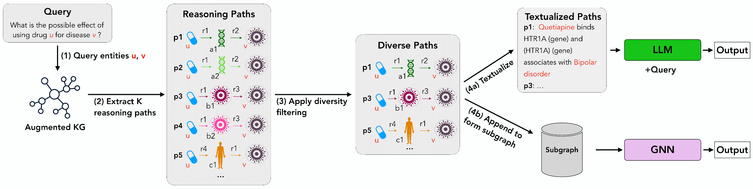
K-Paths Framework Extracts Relevant & Diverse Reasoning Paths from KGs
Zero-shot Learning
Augmented KG (G) = External knowledge graph (KG) + Network of observed interactions
Supervised Learning
Retrieves a set of 𝐾 shortest paths between two entities, {𝑢, 𝑣 }, from G using Yen’s algorithm.
Diversity filtering removes relational redundancy, resulting in diverse paths
Input
Paths are transformed into natural language descriptions for LLM inference.
Paths can also be transformed into Subgraphs for lighter GNN training.
Notes:
(1) Given a query about the effect of an entity (u) on another entity (v), (2) K-Paths extracts reasoning paths from an augmented KG connecting (u) and (v). (3) These paths are filtered for diversity and (4a) transformed into natural language descriptions for LLM inference. (4b) The retrieved paths can also be used to construct a subgraph, enabling GNNs to leverage more manageable information for training and prediction.

Slide 12
Experimental Setup: Datasets
External Knowledge - Hetionet
-a biomedical KG curated from 29 databases.
- includes entities such as compounds, genes, diseases, etc.
- includes 33,765 nodes and 1,690,693 edges spanning 23 relation types.
Task | Dataset | Number of entities | Prediction categories | Example
Drug-disease prediction | PharmacotherapyDB | 601 drugs, 97 diseases | 3 indications | DrugX treats DiseaseY
Drug-drug interaction prediction | DDInter | 1689 drugs | 3 interaction severity levels | Severity: Major (DrugX + DrugY)
 | Drugbank | 1710 drugs | 89 metabolic interaction levels | DrugX decreases excretion rate of DrugY
Notes:
Typo in the hetionet section. Check paper.

Slide 13
Experimental Setup: Datasets
External Knowledge - Hetionet
-a biomedical KG curated from 29 databases.
- includes entities such as compounds, genes, diseases, etc.
- includes 33,765 nodes and 1,690,693 edges spanning 23 relation types.
Task | Dataset | Number of entities | Prediction categories | Example
Drug-disease prediction | PharmacotherapyDB | 601 drugs, 97 diseases | 3 indications | DrugX treats DiseaseY
Drug-drug interaction prediction | DDInter | 1689 drugs | 3 interaction severity levels | Severity: Major (DrugX + DrugY)
 | Drugbank | 1710 drugs | 89 metabolic interaction levels | DrugX decreases excretion rate of DrugY
Notes:
Typo in the hetionet section. Check paper.

Slide 14
Experimental Setup: Datasets
External Knowledge - Hetionet
-a biomedical KG curated from 29 databases.
- includes entities such as compounds, genes, diseases, etc.
- includes 33,765 nodes and 1,690,693 edges spanning 23 relation types.
Task | Dataset | Number of entities | Prediction categories | Example
Drug-disease prediction | PharmacotherapyDB | 601 drugs, 97 diseases | 3 indications | DrugX treats DiseaseY
Drug-drug interaction prediction | DDInter | 1689 drugs | 3 interaction severity levels | Severity: Major (DrugX + DrugY)
 | Drugbank | 1710 drugs | 89 metabolic interaction levels | DrugX decreases excretion rate of DrugY
Notes:
Typo in the hetionet section. Check paper.

Slide 15
Experimental Setup: Baseline Methods
LLM-based Baselines: evaluate the impact of K-Paths on LLM reasoning in zero-shot setting.
Reasoning based on internal knowledge (Base)
Reasoning based on textual definitions (Definitions)
💊 Query: What is the interaction severity between Ritonavir and Leflunomide?
Definitions:
- Ritonavir, a HIV protease ...
- Leflunomide, a pyrimidine inhibitor…
GNN-based Baselines: evaluate the impact of K-Paths on GNNs in a supervised setting.
Complete Graph-based Prediction (Complete KG): The GNN uses the entire augmented KG to predict interactions, considering all entities and relationships.

Slide 16
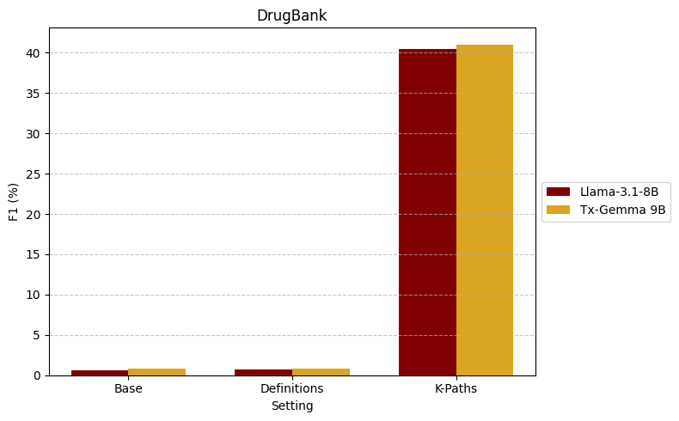
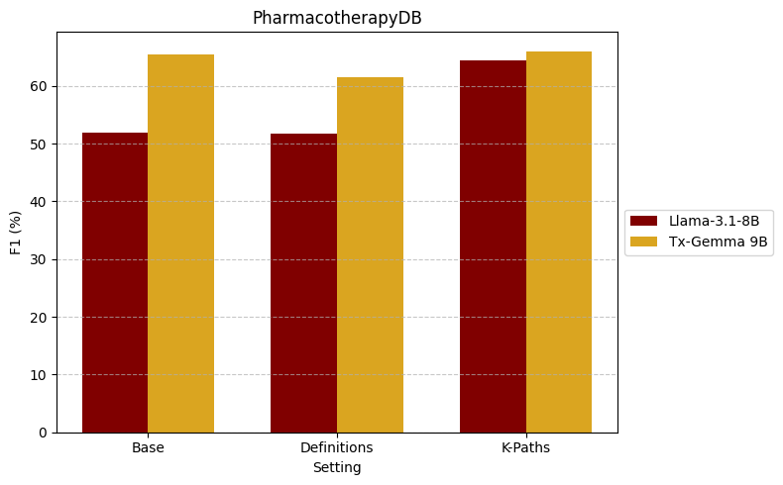
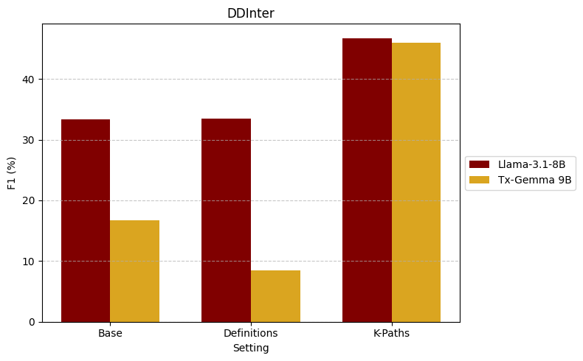
Results: K-Paths Improves LLM Reasoning in a Zero-Shot Setting
Can LLMs accurately predict interaction types, severities, or indications by reasoning over multi-hop paths provided as context in a zero-shot setting?
LLM methods
Drug-disease prediction task
Drug-drug interaction prediction task
Note, the models are not trained on the datasets of interest, yet they can generalize easily across tasks
Evaluation metric: F1-score (higher is better)
Notes:
Across all datasets, LLMs significantly benefit from the diverse reasoning paths, outperforming both the Base and Definitions settings/
Definitions, while informative, provide declarative knowledge without this crucial relational context, making it harder for LLMs to reason about interactions effectively.
Model scaling (70B vs. 8B) demonstrates better reasoning ability with consistent performance improvements, but the gains diminish when external knowledge is provided. This suggests that highquality external knowledge may reduce the reliance on larger parameter models

Slide 17
Results: K-Paths allows for explainable inference
💊 Query (DDInter): What is the interaction severity between Ritonavir and Leflunomide?
LLM Only: Moderate
LLM + Definitions: Moderate
Definitions
Ritonavir, a HIV protease inhibitor, boosts other protease inhibitors’. It increases drug concentrations.
Leflunomide, a pyrimidine inhibitor belongs to disease-modifying antirheumatic drugs pharmacologically heterogeneous
LLM + K-Paths: ✅ Major
Reasoning Path:
Ritonavir binds CYP2C9 (Gene) and CYP2C9 (Gene) is bound by Leflunomide
Ritonavir causes Neutropenia (Side Effect), and Neutropenia (Side Effect) is caused b by Leflunomide
Notes:
Without external knowledge, the Base model often predicts incorrectly, demonstrating insufficient domain knowledge.
simply providing factual information (definitions) without explicit relational information is insufficient for correct reasoning in interaction prediction.
LLM+K-Paths setting demonstrate that while Definitions provide some information about query entities, structured, diverse KG paths are essential for effective contextualization and improved zero-shot performance.

Slide 18
Results: K-Paths allows for LLM explainable inference
🧪 Query (PharmacotherapyDB): What is the effect of using Vincristine for Muscle cancer?
LLM Only: Non Indications
LLM + Definitions: Non Indications
Definitions:
Vincristine is an antitumor that treats leukemia, lymphoma, and other blood disorders.
Muscle cancer is a musculoskeletal system cancer located in the muscle.
LLM + K-Paths: Disease Modifying ✅
Reasoning Paths:
Vincristine treats Kidney Cancer, which resembles Muscle Cancer
Vincristine downregulates TP53, which is associated with Muscle Cancer
Notes:
Without external knowledge, the Base model often predicts incorrectly, demonstrating insufficient domain knowledge.
simply providing factual information (definitions) without explicit relational information is insufficient for correct reasoning in interaction prediction.
LLM+K-Paths setting demonstrate that while Definitions provide some information about query entities, structured, diverse KG paths are essential for effective contextualization and improved zero-shot performance.

Slide 19
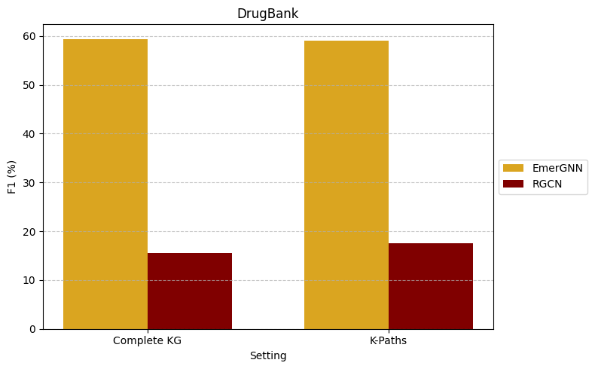
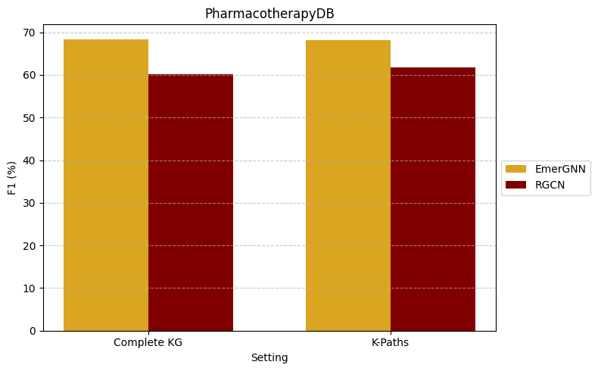
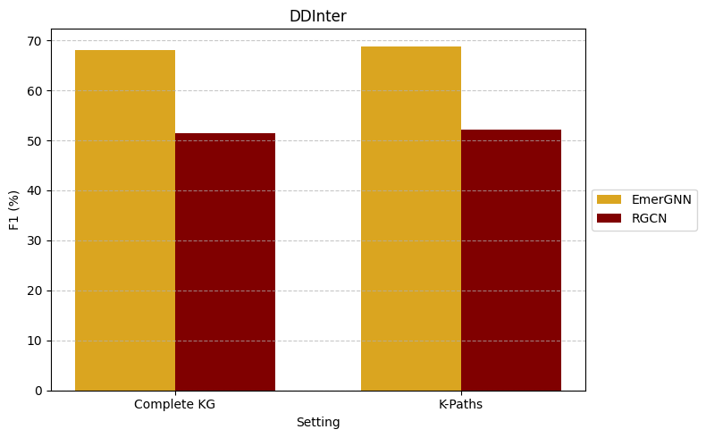
Results: Impact of K-Paths Derived Subgraphs in Supervised Settings
GNN methods
Drug-disease prediction task
Drug-drug interaction prediction task
~1.7 million triplets
~100 thousand triplets
~1.7 million triplets
~11 thousand triplets
~1.7 million triplets
~200 thousand triplets
By reducing the KG by ~90%, K-Paths improves training efficiency
Evaluation metric: F1-score (higher is better)
Triplet = (entity1, entity2, relation)
Notes:
In GNN setting K-Paths achieve comparable accuracy to using the Complete KG despite being approximately 90% smaller.
we observe that supervised fine-tuning enables LLMs to outperform GNNs on most datasets, suggesting that supervised LLMs can effectively leverage multiple structured and unstructured modalities and sometimes even surpass GNNs trained solely on relational graphs.

Slide 20
Broader Benefits and Use Cases
Explainable Drug Repurposing and Drug Safety alerts.
Precision Medicine- Tailor drug recommendations to individuals based on their genetic profiles
Clinical Decision Support –Provide clinicians with explainable recommendations off the shelf.
Cost Effective Validation Analysis

Slide 21


Conclusion
K-Paths is a novel path retrieval framework that extracts relevant and diverse reasoning paths from large biomedical KGs.
K-Paths enables LLMs to effectively reason about and predict unobserved interactions between emerging drugs and diseases.
K-Paths significantly reduce the computational burden of training GNNs on large-scale KGs.
K-Paths provides valuable insights into biomedical interactions by enhancing explainability.
Pre-print
GitHub
https://arxiv.org/abs/2502.13344
https://github.com/rsinghlab/K-Paths

Slide 22







K-Paths Team ☺
Ritambhara Singh (Brown University)
Ioanna Gemou (TU Denmark)
Nihal Nayak
(Brown University)
Ghulam Murtaza
(Brown University)
Steven Bach
(Brown University)
Carsten Eickhoff
(University of Tübingen)

Slide 23
Shortest Path
r4
r5
r4
r6
r3
u
r7
r3
r8
r7
r2
r1
r1
v
Removes: Drug u – r7 – disease
Path 2: Drug u – r1 – anatomy –r1 –Drug v

Slide 24
Finding K Shortest Paths with Yen's Algorithm
r4
r5
r4
r6
r3
u
r7
r3
r8
r7
r2
r1
r1
v
Path 1: Drug u – r7 – disease –r7 –Drug v
Path 1: Drug u – r7 – disease –r3 –gene-r2-Drug v
Notes:
Finding K Shortest Paths with Yen's Algorithm
Using Dijkstra's Algorithm as a Building Block
Efficient discovery of multiple loopless routes in a graph

Slide 25
Shortest Path
r4
r5
r4
r6
r3
u
r7
r3
r8
r7
r2
r1
r1
v
Removes: Drug u – r7 – disease and Drug u – r1 – anatomy
Path 3: Drug u – r5 – gene –r4 –disease-r7-Drugv

Slide 26
Shortest Path
r4
r5
r4
r6
r3
u
r7
r3
r8
r7
r2
r1
r1
v
Removes: Drug u – r7 – disease and Drug u – r1 – anatomy
Path 3: Drug u – r5 – gene –r4 –disease-r3-gene-r2-Drugv

Slide 27
Shortest Path
r4
r5
r4
r6
r3
u
r7
r3
r8
r7
r2
r1
r1
v

